Slide 1
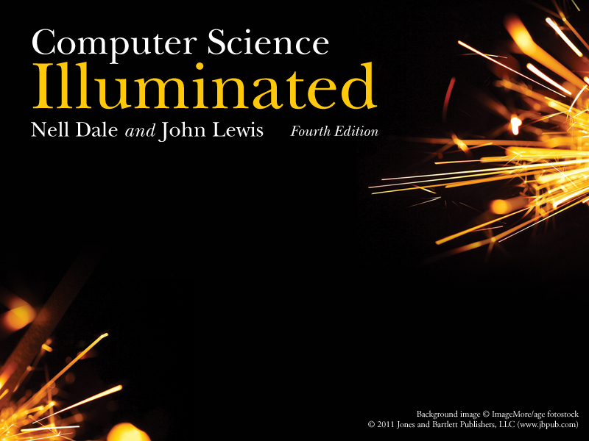
Chapter 5 5
Computing Components

Slide 2
Chapter Goals
  Read an ad for a computer and understand the jargon(術語)
  List the components and their function
  in a von Neumann machine
  Describe the fetch-decode-execute cycle of the von Neumann machine
  Describe how computer memory is organized and accessed

Slide 3
Chapter Goals
Name and describe different auxiliary storage devices
Define three alternative parallel computer configurations
Explain the concept of embedded systems and give examples from your own home

Slide 4
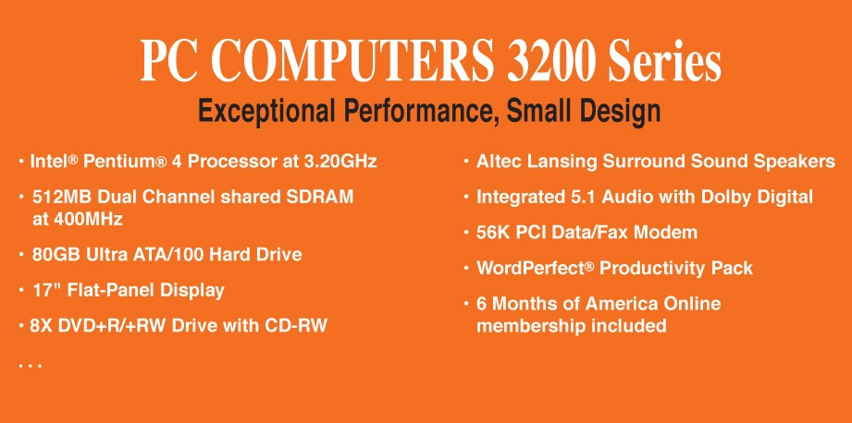
Computer Components
Consider the following ad:
Insatavialion 640 Laptop
Exceptional Performance and Portability
• Intel® Core™ 2 Duo (2.66GHz/1066Mhz
FSB/6MB cache)
• 15.6” High Definition (1080p) LED
Backlit LCD Display (1366 x 768)
• 512MB ATI Mobility Radeon Graphics
• Built-in 2.0MP Web Camera
• 4GB Shared Dual Channel DDR2 at
800MHz
• 500GB SATA Hard Drive at 5400RPM
• 8X Slot Load DL DVD+/- RW Drive
• 802.11 a/g/n and Bluetooth 3.0
• 85 WHr Lithium Ion Battery
• (2) USB 2.0, HDMI, 15-pin VGA, Ethernet
10/100/1000, IEEE 1394 Firewire, Express
Card, Audio line-in, line-out, mic-in
• 14.8W X 1.2H X 10.1D, 5.6 lbs
• Microsoft0® Windows 7® Professional
• Microsoft® Office Home and Student
2007
• 36-Month subscription to McAfee
Security Center Anti-virus

Slide 5
Computer Components (1/2)
What does all this jargon mean?
Intel® Core™ 2 Duo (2.66GHz/1066Mhz FSB/ 6MB cache)
4GB Shared Dual Channel DDR2 at 800 MHz
500 GB SATA Hard Drive at 5400RPM
15.6” High Definition (1080p) LED Backlit
LCD Display (1366 x 768)
8X Slot Load DL DVD+/- RW Drive
14.8”W X 1.2”H X10.1” D, 5.6 lbs.
Be patient!
If you don't
know now, you
should know
shortly

Slide 6
Computer Components (2/2)
512 MB ATI Mobility Radeon Graphics
85 WHr Lithium Ion Battery
(2) USB 2.0, HDMI, 15-Pin VGA, Ethernet 10/100/1000 IEEE 1394 Firewire, Express Card, Audio line-in, line-out, mic-in
Microsoft® Windows 7® Professional
Microsoft® Office Home and Student 2007
36-Month subscription to McAfee Security Center Anti-virus

Slide 7
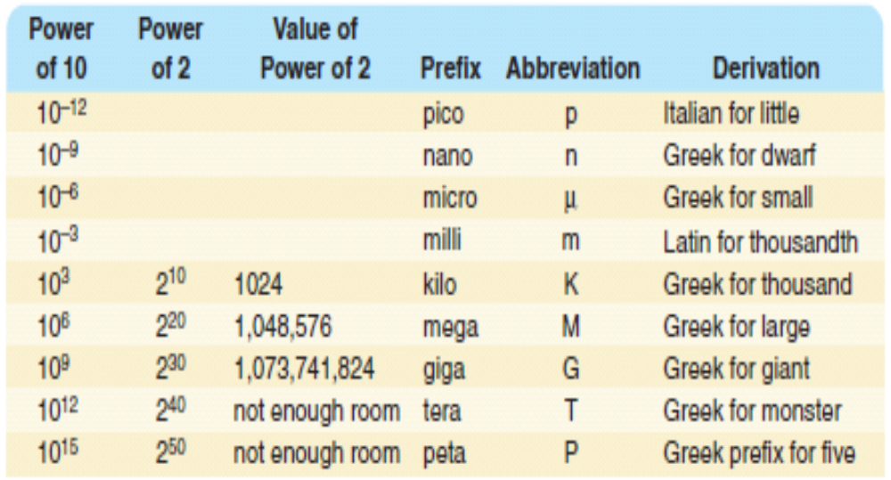
Sizes in Perspective
(侏儒)

Slide 8
Sizes in Perspective
Intel Processor
speed 2.66 GHz
SDRAM
size 4GB
speed 800 MHz
500GB SATA at 5400 RPM
Transfer rate 300MB per second
Flat screen dot pitch .28mm
To which do these
apply?
Bigger is better
Faster is better
Smaller is better

Slide 9
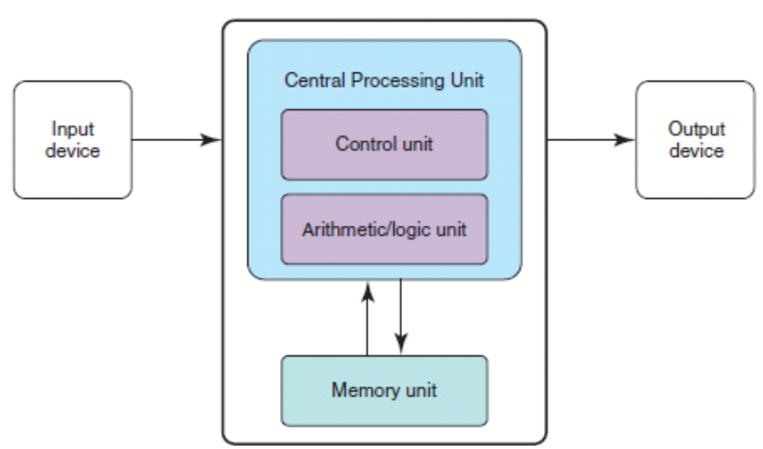
Stored-Program Concept
The von Neumann architecture

Slide 10
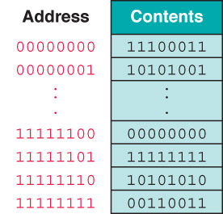

Memory
Memory
A collection of cells,
each with a unique
physical address; both
addresses and
contents are in
binary

Slide 11
Arithmetic/Logic Unit
Performs basic arithmetic operations such as adding
Performs logical operations such as AND, OR, and NOT
Most modern ALUs have a small amount of special storage units called registers

Slide 12
Control Unit
Control unit
The organizing force in the computer
Instruction register (IR)
Contains the instruction that is being executed
Program counter (PC)
Contains the address of the next instruction to be
executed
Central Processing Unit (CPU)
ALU and the control unit called the, or CPU

Slide 13
Input/Output Units
Input Unit
A device through which data and programs from
the outside world are entered into the computer;
Can you name three?
Output unit
A device through which results stored in the
computer memory are made available to the
outside world
Can you name two?

Slide 14
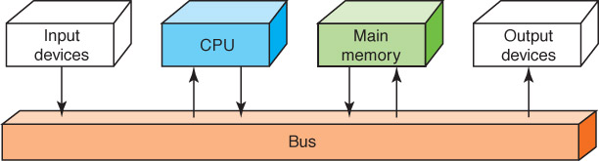
Flow of Information
Bus
A set of wires that connect all major sections
Figure 5.2 Data flow through a von Neumann architecture

Slide 15
The Fetch-Execute Cycle
Fetch the next instruction
Decode the instruction
Get data if needed
Execute the instruction
Why is it called a cycle?

Slide 16
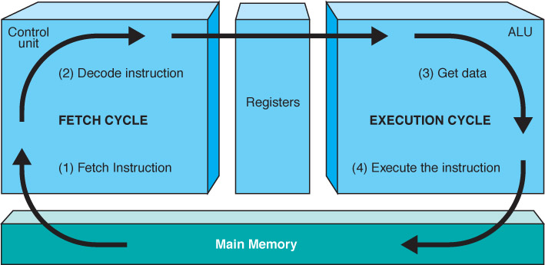
The Fetch-Execute Cycle
Figure 5.3 The Fetch-Execute Cycle

Slide 17
RAM and ROM
Random Access Memory (RAM)
Memory in which each location can be accessed and changed
Read Only Memory (ROM) 韌體 Firmware
Memory in which each location can be accessed but not changed
RAM is volatile(易失性) , ROM is not
What does volatile mean?

Slide 18
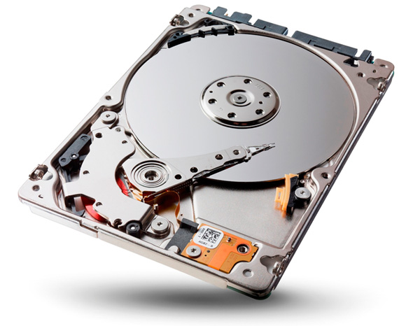
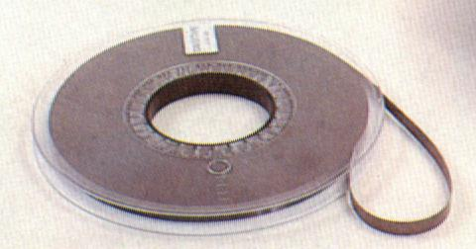
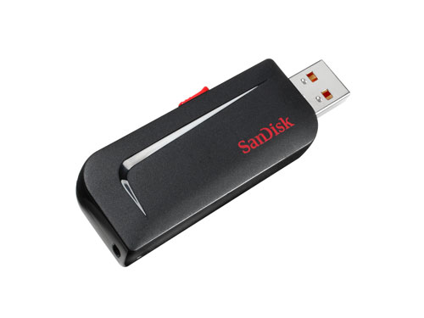
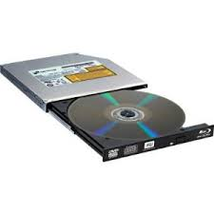
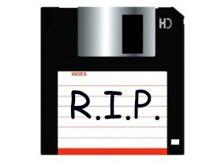
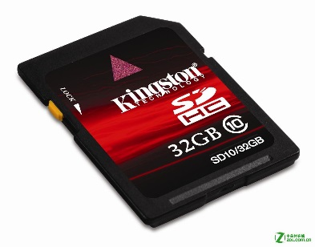

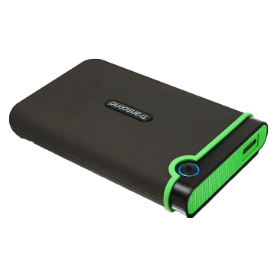
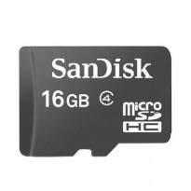
Secondary Storage Devices

Slide 19
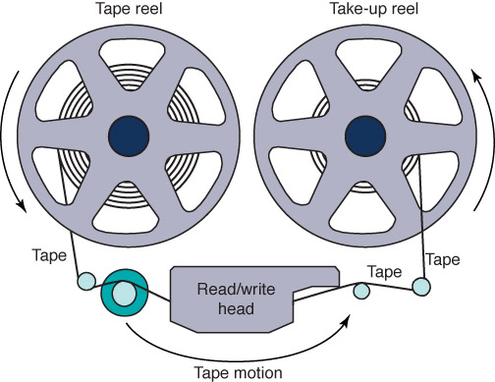
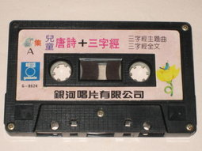
Magnetic Tape
The first truly mass auxiliary storage device was the magnetic tape drive
Figure 5.4 A magnetic tape

Slide 20
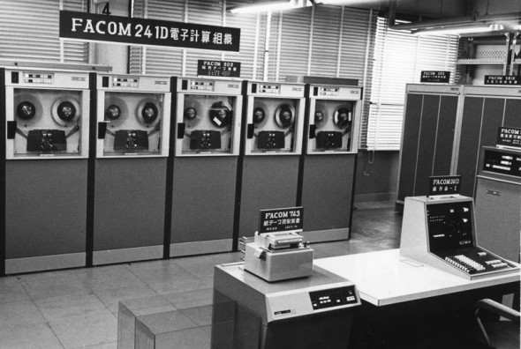

Slide 21
Tape drives have a major problem; can you describe it?
價格太貴
存取速度太慢
容量太小
技術太老舊

Slide 22
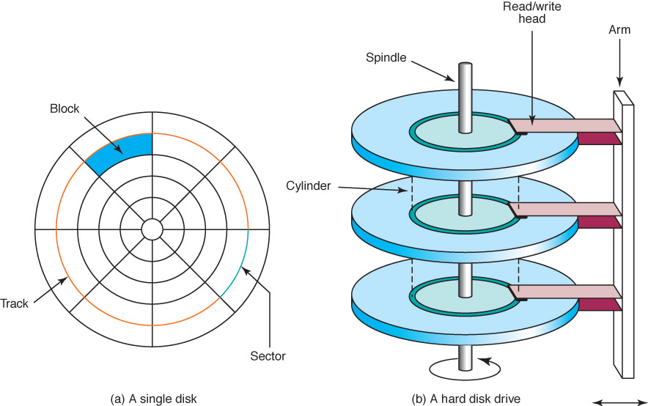
Magnetic Disks
Figure 5.5 The organization of a magnetic disk

Slide 23
Assume a disk has 2 surfaces, 64 tracks per surface, 16 sectors per track, and 1024 bytes per sector.
How many bytes can be stored on this disk?
2KB
2MB
2GB
2TB

Slide 24
Magnetic Disks
History
Floppy disks (Why "floppy"?)
1970 - 8" in diameter "
late 1970 - 5 1/2"
now - 3 1/2"
Zip drives
Tracks near center are more densely packed Why?

Slide 25
Magnetic Disks
Seek time
Time it takes for read/write head to be over right track
Latency
Time it takes for sector to be in position
Access time
Can you define it?

Slide 26
Suppose the seek time of a disk access is 35ns, the latancy time is 28ns, what is the access time?
28ns
35ns
63ns
7ns

Slide 27
Compact Disks
CD
A compact disk that uses a laser to read information stored optically on a plastic disk; data is evenly distributed around track
CD-ROM read-only memory
CD-DA digital audio
CD-WORM write once, read many
RW or RAM both read from and written to
DVD
Digital Versatile Disk, used for storing audio and video

Slide 28
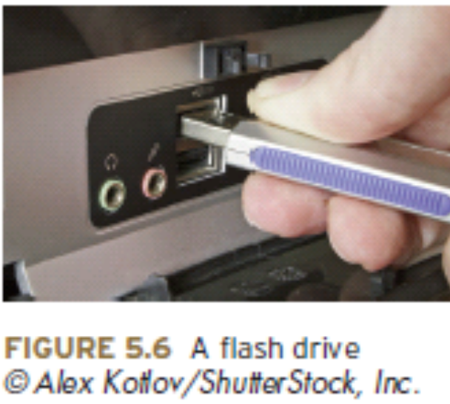
Flash Drives
Flash Memory
Nonvolatile(非揮發性)
Can be erased and rewritten

Slide 29
Which of the following devices are made by flash memory?
Magnetic Tapes
Magnetic Disks
USB Disk
SD Card
SSD
Memory Stick

Slide 30
Touch Screens
Touch screen
A computer monitor that can respond to the user touching the screen with a stylus(觸控筆) or finger
There are four types
  Resistive(電阻式)
  Capacitive(電容式)
  Infrared(紅外線式)
  Surface acoustic wave (SAW) (音波式)

Slide 31
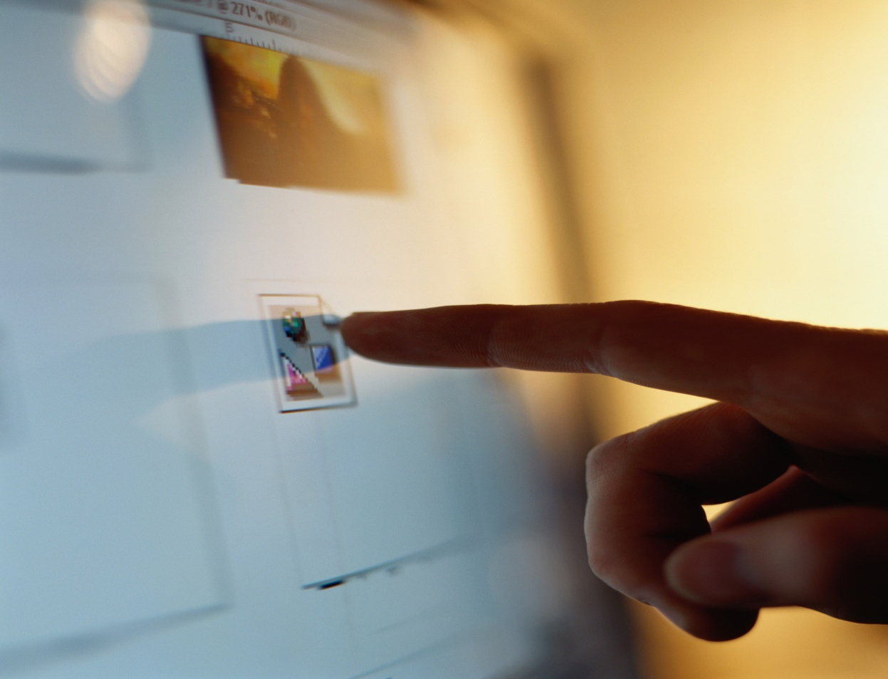
Touch Screens
Figure 5.7
A touch screen
(Randy
Allbritton/
Photodisc/
Getty Images
© 2003

Slide 32
Touch Screens
Resistive touch screen
A screen made up of two layers of electrically conductive material
  One layer has vertical lines, the other has horizontal lines
  When the top layer is pressed, it comes in contact with the second layer which allows electrical current to flow
  The specific vertical and horizontal lines that make contact dictate the location on the screen that was touched

Slide 33
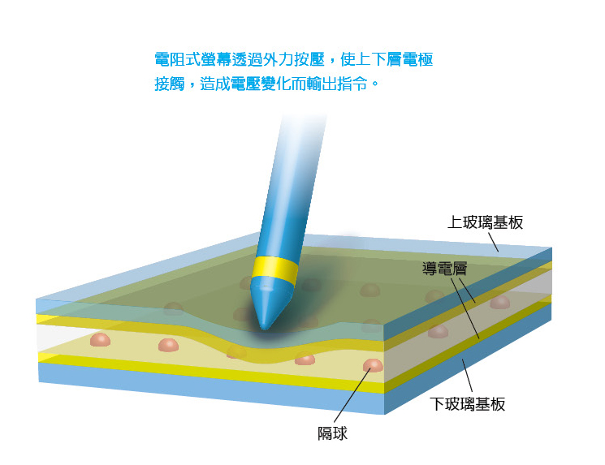
Touch Screens
Resistive touch screen

Slide 34
Touch Screens
Capacitive touch screen
A screen made up of a laminate(薄片) applied over a glass screen
  Laminate conducts electricity in all directions; a very small current is applied equally on the four corners
  When the screen is touched, current flows to the finger or stylus
  The location of the touch on the screen is determined by comparing how strong the flow of electricity is from each corner

Slide 35
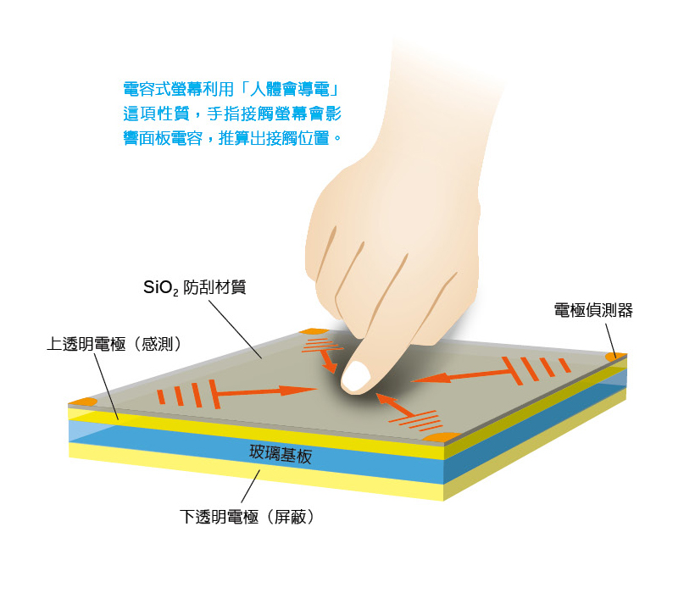
Touch Screens
Capacitive touch screen

Slide 36
Touch Screens
Infrared touch screen
A screen with crisscrossing(十字型) horizontal and vertical beams of infrared light
  Sensors on opposite sides of the screen detect the beams
  When the user breaks the beams by touching the screen, the location of the break can be determined

Slide 37
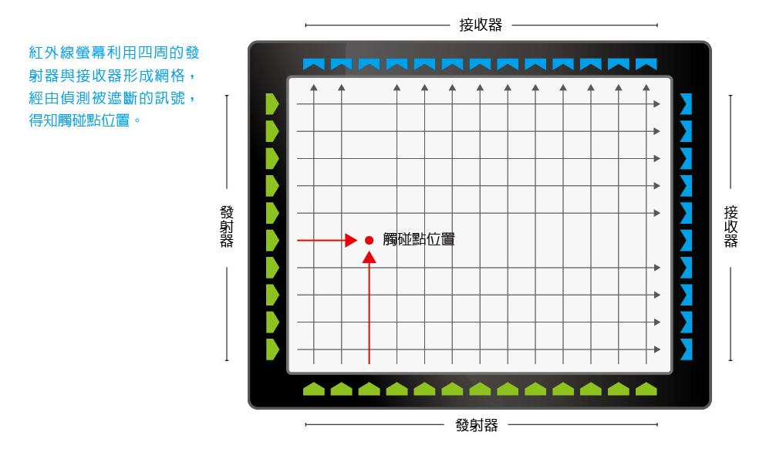
Touch Screens
Infrared touch screen

Slide 38
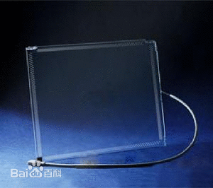
Touch Screens
Surface acoustic wave (SAW)
A screen with crisscrossing high frequency sound waves across the horizontal and vertical axes
  When a finger touches
  the surface, corresponding
  sensors detect the
  interruption and determine
  location of the touch

Slide 39
What is the touch screen technology used in modern smart phone?
Resistive
Capacitive
Infrared
Surface acoustic wave

Slide 40
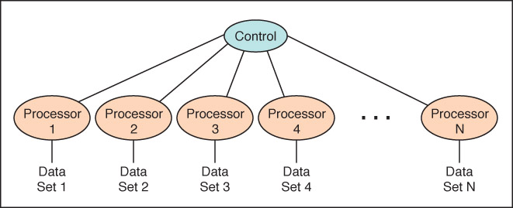
Synchronous processing
One approach to parallelism(平行化) is to have multiple processors apply the same program to multiple data sets
Hyper Threading (HT) 多執行緒
Figure 5.8 Processors in a synchronous computing environment

Slide 41
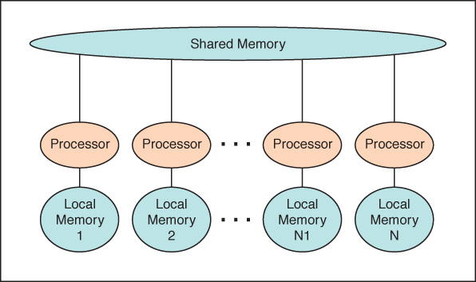
Shared Memory
Parallel Processor
Communicate through shared memory
Multi Core 多核心
Figure 5.10 Shared memory configuration of processors

Slide 42
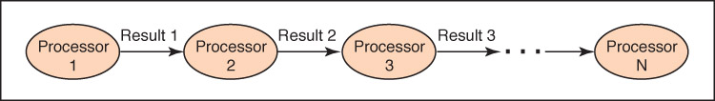
Pipelining
Arranges processors in tandem(串聯) , where each processor contributes one part to an overall computation
Figure 5.9 Processors in a pipeline

Slide 43
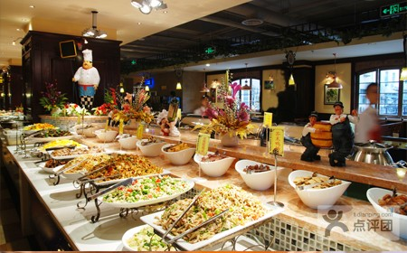
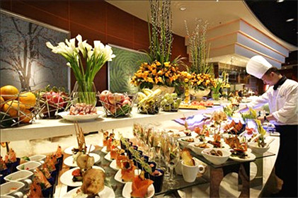
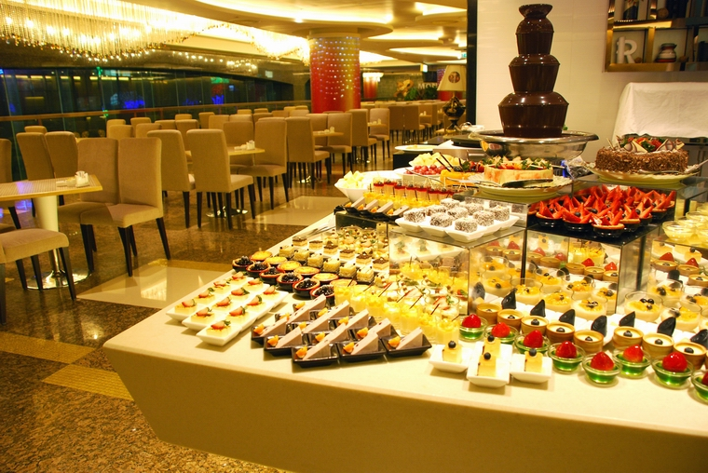
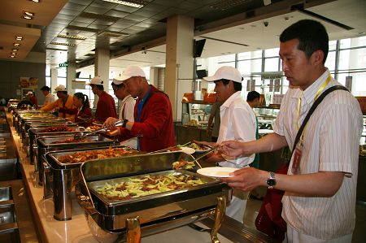
Pipelining

Slide 44
Embedded Systems
Embedded systems
Computers that are dedicated to perform
a narrow range of functions as part of a
larger system

Slide 45
Empty your pockets or backpacks.
What embedded systems do you have?

Slide 46
Ethical Issues
Computer Hoaxes and Scams:
What is the principal difference between a hoax and a scam?
What are the most common complaints of Internet users about computer scams and hoaxes?
What are the most serious crimes perpetrated on the Web?
Why is it so difficult to police these schemes?

Slide 47
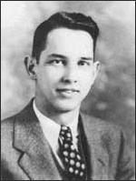
Who am I?
A lawsuit
determined my
legacy.
What
was it all about?

Slide 48

Do you know?
What does "remember your nanoseconds"
mean?
Who was the father of the computer?
What is FIOS?
What did President Obama refuse to give
up?

